Slide 1
NCA Sponsored Training
Day 2 – Afternoon Session (Theory)
Asymmetric Cryptography
Presenter Name: Dr. Danish Vasan
City: Dhahran
16 February 2025
Notes:
Sanjay Goel - University at Albany
Purdue

Slide 2
Outline
Asymmetric Encryption Overview
Introduction to asymmetric cryptography
Advantages and Disadvantages
RSA Algorithm
Basic properties
Crypto system
Example
Real-world usage of Public Key Encryption
Public Key Infrastructures
Digital Certificates and Signatures

Slide 3
Review of Symmetric Cryptography
Confidentiality
Stream ciphers
Block ciphers
Integrity
Cryptographic hash functions
Limitation: sender and receiver must share the same key
Needs secure channel for key distribution
Impossible for two parties having no prior relationship
Needs many keys for n parties to communicate

Slide 4
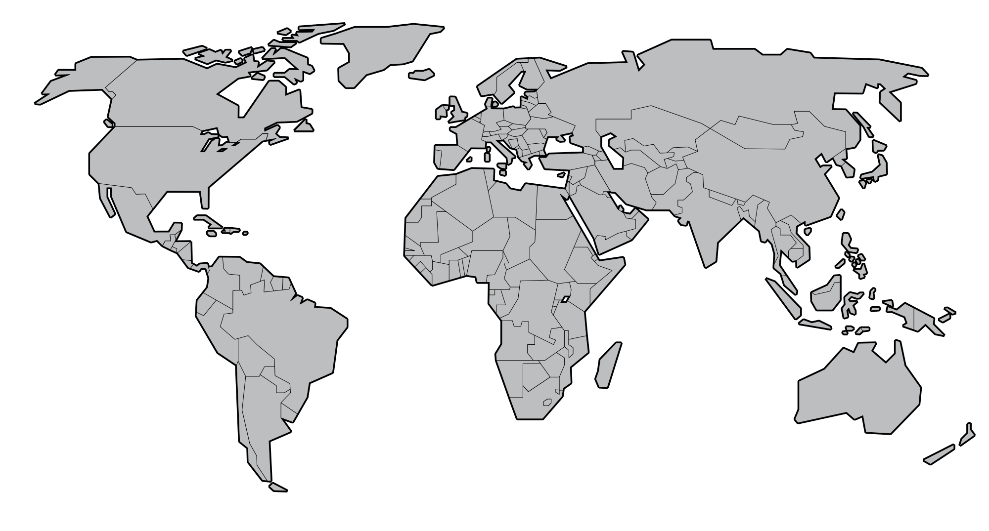
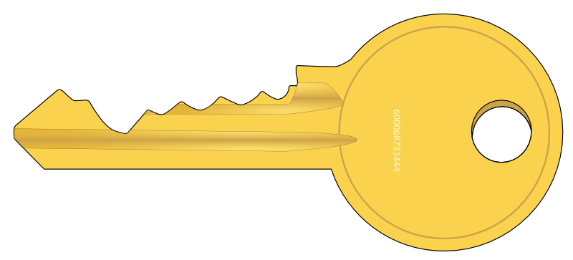

Key Exchange
Traditionally, secure encrypted communication between two parties required that they first exchange keys by some secure physical channel, such as a paper key lists transported by a trusted courier.
Is this physical channel always available?

Slide 5






Asymmetric Cryptography
In asymmetric cryptography, both the sender and receiver have a public and a private key.
The public keys , are publicly available.
The private keys , have to be kept secret.
Public Key (M)
Public Key (B)
Private Key (M)
Private Key (B)

Slide 6
Asymmetric Cryptography
The Milhouse’s public key can reveal messages encrypted with the Milhouse’s private key .
The Milhouse’s private key can reveal messages encrypted with the Milhouse’s public key .
The Bart’s public key can reveal messages encrypted with the Bart’s private key .
The Bart’s private key can reveal messages encrypted with the Bart’s public key .
Public Key (M)
Public Key (B)
Private Key (M)
Private Key (B)

Slide 7
Asymmetric Cryptography - Confidentiality
Public Key (M)
Public Key (B)
Private Key (M)
Private Key (B)
Milhouse hides a message using .
Only Bart with can reveal it.
So, only Bart can read the message

Slide 8



Asymmetric Cryptography - Integrity
Public Key (M)
I can change all the content of the message! MUHAHAHAHAHA
(evil laugh)
Public Key (B)
I cannot reveal the message with …
I don’t trust it!
Private Key (M)
Private Key (B)
Milhouse hides a message using .
Mr. Burns modifies the content
And hides the message using .
Everybody with can reveal it.
(Malicious Mr. Burns too)
Public Key (MB)
Private Key (MB)

Slide 9
Asymmetric Cryptography – Integrity and Confidentiality
Public Key (M)
Public Key (B)
Only Milhouse could have hidden the message
I am the only one who can reveal it
Private Key (M)
Private Key (B)
Milhouse hides a message using .
Then he reveals the message using .
Then he hides the message
again using
Bart reveals the message using .

Slide 10
Asymmetric Cryptography - Recap
Each party has a PAIR (PubK, PrivK) of keys:
PubK is the public key, and used for encryption
PrivK is the private key, and used for decryption
Knowing the public-key PubK, it is computationally infeasible to compute the private-key PrivK
The public-key PubK may be made publicly available, e.g., in a publicly available directory
Many can encrypt, only one can decrypt

Slide 11
Asymmetric Cryptography - Advantages
Key distribution:
Only the private key must be kept secret, the public key can be shared freely.
A key pairs is generated once and used forever (unless the private key is compromised!)
Many use cases:
Confidentiality
Integrity
Authentication and non-repudiation (via digital signatures)

Slide 12
Asymmetric Cryptography - Disadvantages
Strength is dependent on the infeasibility of solving certain hard problems (discrete logarithm, factoring large numbers, etc.)
Calculating 19∗31=589 is easy, but given a large number and asked to determine its two prime factors is computationally difficult
Note that in real systems, the product term is very large
A mathematical breakthrough could provide a feasible way to solve the problem and break the encryption.
Faster computers, quantum computers, etc. could facilitate breaking encryption.

Slide 13
Public Key Cryptography - Early History
Early Origins: James Ellis (1970)
The idea of public-key encryption was first conceptualized in 1970 by James Ellis, a British cryptographer working at GCHQ (Government Communications Headquarters).
His work was classified until 1997 when it was publicly disclosed.
Ellis' research laid the foundation for asymmetric cryptography, though it was unknown to the public at the time.

Slide 14
Public Key Cryptography - Early History
The concept is proposed in Diffie and Hellman (1976) “New Directions in Cryptography ”
public-key encryption schemes
Public key distribution systems
Diffie-Hellman key agreement protocol
digital signature
Concept of digital signature is still originally due to Diffie & Hellman

Slide 15
Public Key Encryption Algorithms
Almost all public-key encryption algorithms use either number theory and modular arithmetic.
RSA
based on the hardness of factoring large numbers
El Gamal
Based on the hardness of solving discrete logarithm

Slide 16
RSA Algorithm
Invented in 1978 by Ron Rivest, Adi Shamir, and Leonard Adleman – Published as R L Rivest, A Shamir, L Adleman, "On Digital Signatures and Public Key Cryptosystems", Communications of the ACM, vol 21 no 2, pp 120-126, Feb 1978
Security relies on the difficulty of factoring large composite numbers

Slide 17
RSA Public Key Crypto System
Key Generation:
Select 2 large prime numbers of about the same size, p and q
Compute n = pq, and φ(n) = (q-1)(p-1)
Select e: 1<e<φ(n) s.t. gcd(e, φ(n))= 1
Compute d: 1 < d < φ(n) s.t. ed mod φ(n) = 1
Public key: (e, n)
Private key: d

Slide 18
RSA Properties
C = Me mod n
Plaintext: M
Ciphertext: C
C^{d} mod n
From n, difficult to compute p, q
From (n, e), difficult to compute d
From (n, e) and C, difficult to compute M

Slide 19
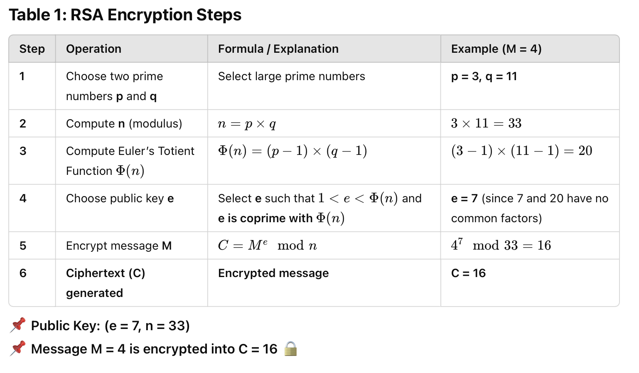

Slide 20
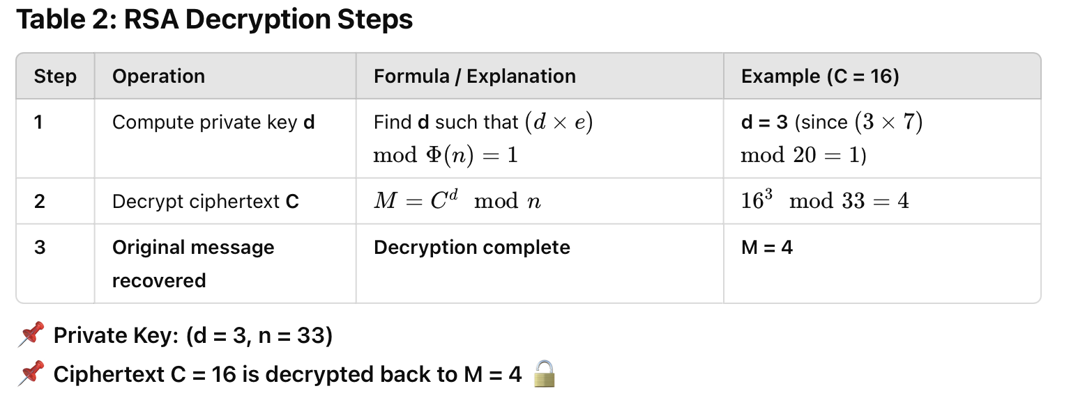

Slide 21
RSA Exercise
p = 47 and q = 71
Compute n and φ(n)
Now pick a value of e which does not share a factor with φ(n)
You can factorize a number here: https://factordb.com
Now select a value of d, so that (ed) (mod φ(n)) = 1
You can compute d here: https://asecuritysite.com/encryption/inversemod
Now for a message of M=688, calculate the cipher
Now decrypt your ciphertext
Did you get the value of your message back (M=688)? If not, you have made a mistake, so go back and check.
Notes:
N = 3337
φ(n) = 3220
E = 79
D = 1019
Chipher = 1570

Slide 22

Break Time…
Be back in 10 min

Slide 23
Security of RSA: The Role of Factoring n
RSA Security Relies on the Hardness of Factoring n=p×q
RSA encryption depends on the difficulty of factoring a large number n, where:
n=p×q, where p and q are large prime numbers.
The Euler totient function: ϕ(n)=(p−1)(q−1)
The private key d is computed from the public exponent e and ϕ(n), making it essential to keep ϕ(n) secret.
If an attacker factors n, they can determine ϕ(n) and compute d, breaking RSA encryption.

Slide 24
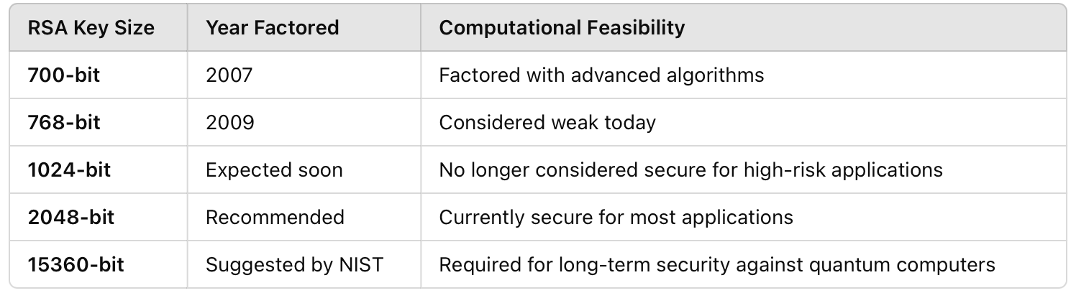
Strength of RSA Over Time (Factoring Records)

Slide 25
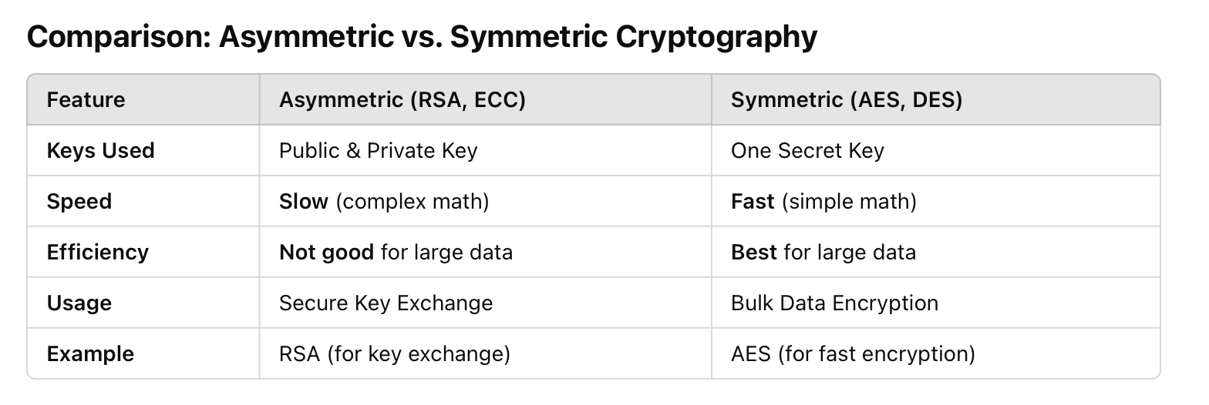
Real World Usage of Public Key Encryption

Slide 26
Digital Signatures
A digital signature is like an electronic fingerprint that verifies who sent a message and that it hasn’t been changed. It’s mainly used in online security, banking, and secure communication.
What does it do?
Proves the sender’s identity (Authentication)
Ensures the message is not altered (Data Integrity)
Prevents the sender from denying sending the message (Non-Repudiation)

Slide 27
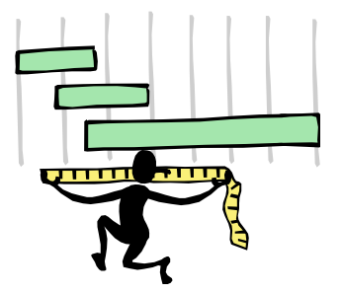
Digital Signatures
Very often digital signatures are used with hash functions
The hash of a message is signed, instead of the message.

Slide 28
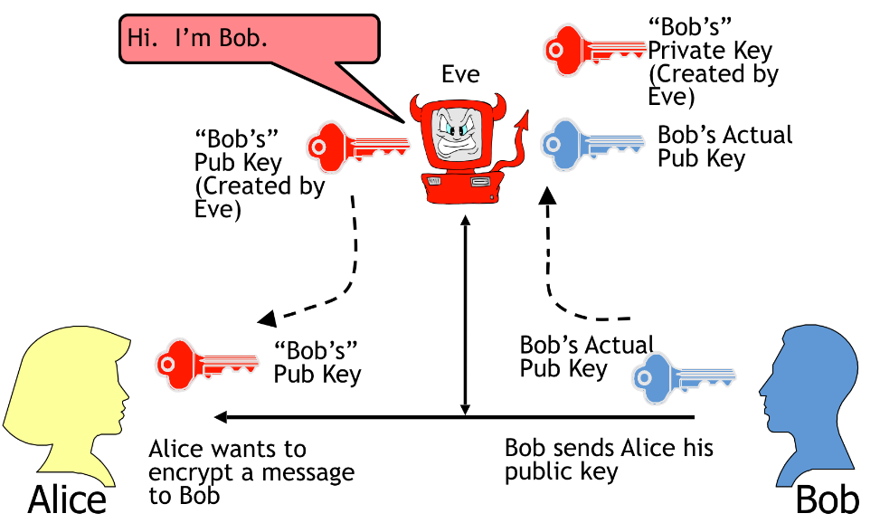
MitM Attack Against Asymmetric Key Systems

Slide 29
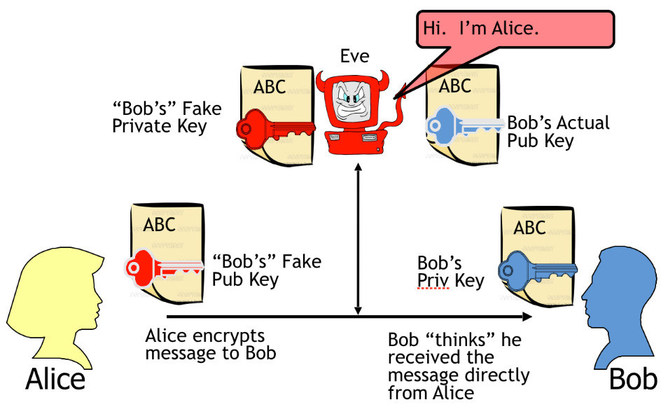
MitM Attack Against Asymmetric Key Systems

Slide 30
Asymmetric Key Systems - Problem
How do we know we are really talking to the right party? (Anyone can send you a public key to use)
A digital signature only ties a message to a private key, not to a person.
We need a way to bind a public/private key pair to a specific individual.

Slide 31
Asymmetric Key Systems - Solution
Public Key Infrastructure (PKI)
A trusted third party, called certificate authority (CA), vouches for the individuals and their keys.
A registration authority (RA) issues digital certificates that bind key pairs to identities.
Certificates can be created for people, organizations, or specific computers.
The PKI includes mechanisms to issue, revoke, and verify certificates.

Slide 32
Public Key Infrastructure (PKI)
The issuer digitally signs the certificates, allowing us to verify their authenticity and integrity.
There may be multiple layers of certificates verifying others in a ‘tree of trust’ or ‘web of trust’.
A CA has one or more root certificates that we must trust implicitly.
Certificates have an expiration date. The CA may issue a certificate revocation list (CRL) of certificates that have not expired but should not be trusted.

Slide 33
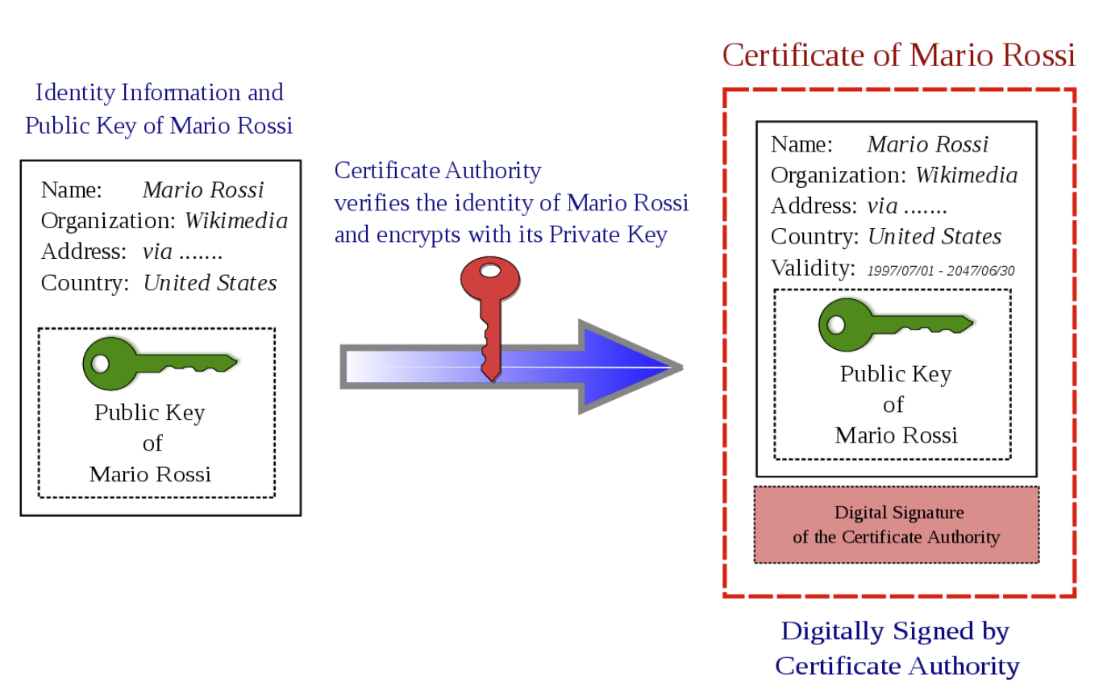
Public Key Certificates

Slide 34
X.509 Certificates
Defines framework for authentication services
The most widely accepted format for certificates is defined by the ITU-T X.509 version 3 international standards.
The certificates are encoded using OSI ASN.1 DER.
Used by numerous applications: SSL, IPSec, SET

Slide 35
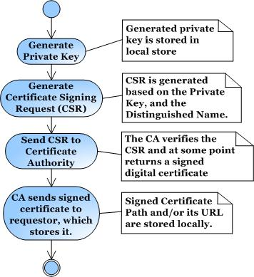
How to Obtain a Certificate?
Define your own CA (use openssl or Java Keytool)
Certificates unlikely to be accepted by others
Obtain certificates from one of the vendors: VeriSign, Thawte, and many others

Slide 36
CAs and Trust
Certificates are trusted if signature of CA verifies
Chain of CA’s can be formed, head CA is called root CA
In order to verify the signature, the public key of the root CA should be obtained.
TRUST is centralized (to root CA’s) and hierarchical
What bad things can happen if the root CA system is compromised?

Slide 37
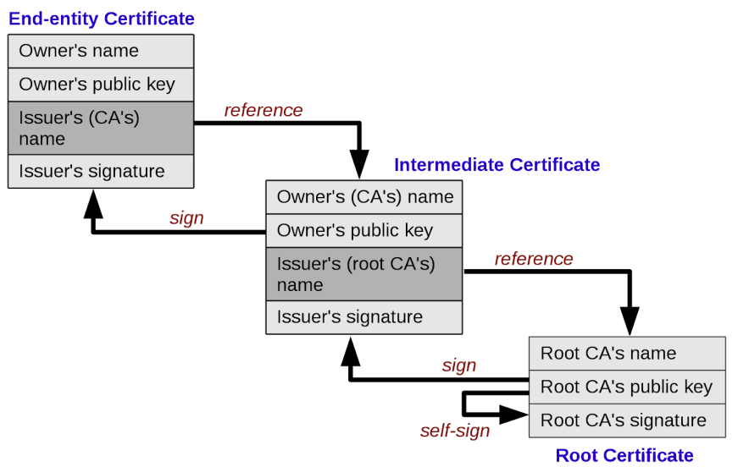
CAs – Chain of Trust
Notes:
A single key also means a single point of failure- if it’s compromised, then all certificates signed by that CA cannot be trusted.
https://www.cs.toronto.edu/~arnold/427/19s/427_19S/tool/ssl/notes.pdf

Slide 38

Do you have any questions?

